Slide 1
Introduction To Data Types

Slide 2
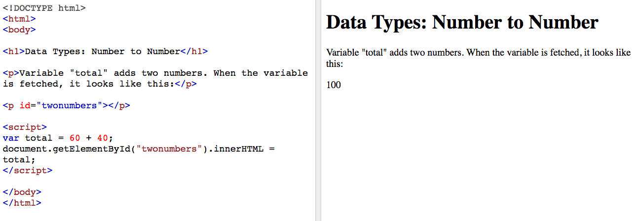
In JavaScript, data can be numeric. See how the variable in this code adds 60 and 40 to render as 100?

Slide 3
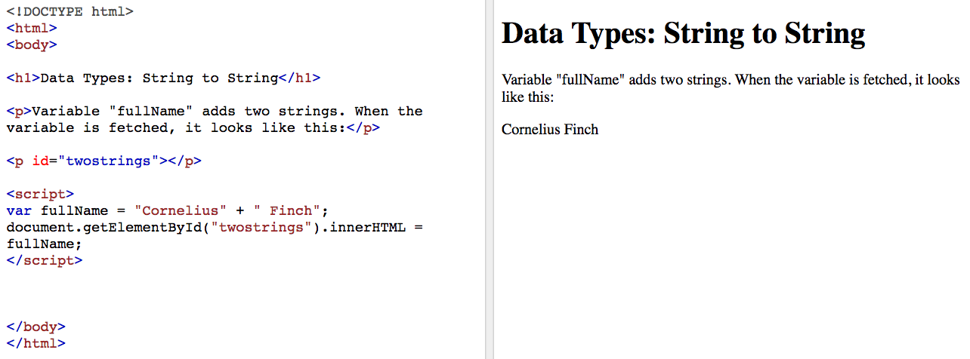
Introduction To Data Types (Continued)
Data can also be strings of characters. See how the variable in this code puts the two names together to render as a full name?

Slide 4
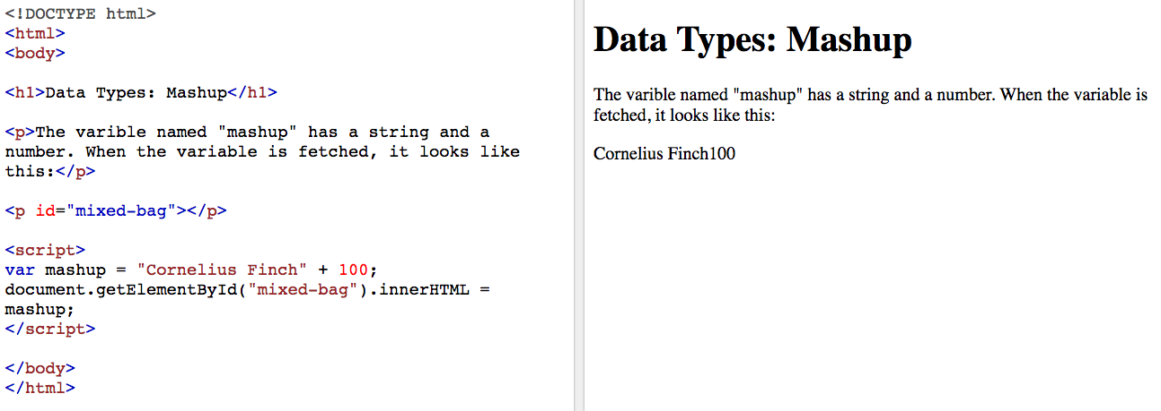
Introduction To Data Types (Continued)
But, what if we mix up two types of data? What if we declare our variable to be the sum of a name and a number? Will our code break? Nah, JavaScript will just treat the number as a string.

Slide 5
Data Types Defined
In computer science and computer programming, a data type, or simply "type," is a classification that determines possible values for data that match its criteria, the operations that can be performed on these values, the meaning of the data, and the way values can be stored.

Slide 6
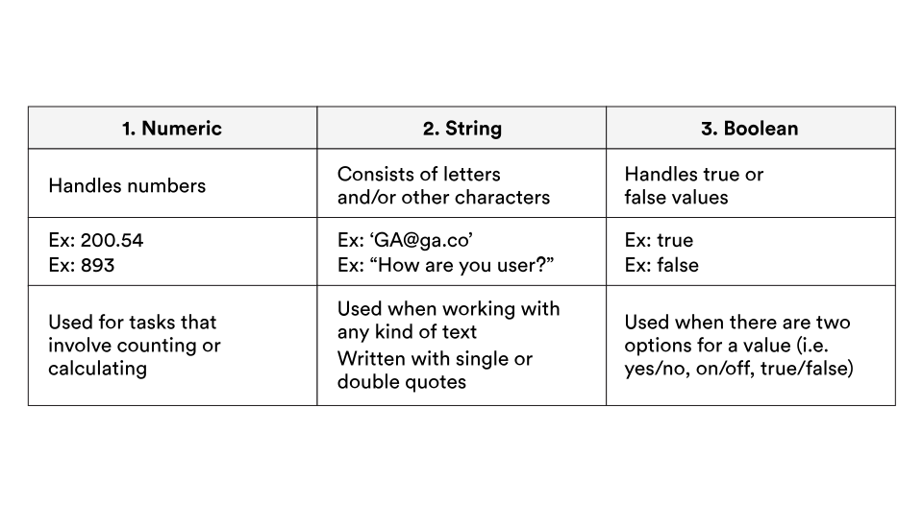
Data Types Across Languages
Data types are really similar across different programming languages. So, once you're well-versed in how and when to use them in JavaScript, you'll be able to cruise into any language with some base knowledge.
We'll elaborate on all of these types — except Booleans, for now.

Slide 7
Numbers vs. Strings
Notice that in JavaScript, you don't need to declare the type of data you're using.
For example, when you code:
var a = 13; var b = "thirteen";
JS will know that var a is a number and var b is a string because strings always have quotation marks. Using quotation marks is a way of communicating to the processor what type of data to expect.
If you put quotations marks around a number, like so "9", the processor will read it as a string. You should always be mindful of the type of data you use moving forward.

Slide 8
The "typeof" Command
When we start writing more complex code, there may be times when we forget which type of data we're manipulating. Luckily, the computer already knows which type of data we're working with, so we can use the typeof command in the console to find the answer.
typeof returns a string that tells us which type of data we're seeing.
Take a look at some examples:
typeof 5; // => "number" typeof "John Doe"; // => "string" typeof true; // => "boolean"
Make sure to remember the typeof command in case you ever need to find out the type of data with which you are working.

Slide 9
Try It!
Add each line of code to the JS Bin console and hit return to run that line of code.
typeof 'hello';
The console returns string.
typeof 24;
The console returns number.
typeof 3.45;
The console returns number.
typeof true;
The console returns boolean.
typeof "JS is fun!";
The console returns string.

Slide 10
Strings
Strings are collections of letters and symbols known as characters, and we use them to deal with words and text in JavaScript. They come in two varieties, 'single-quote' and "double-quote."
Although there are some differences between the two, don't worry about them for now. For the purposes of your work in Web Development Fundamentals, they're interchangeable.
Strings are typically used to store text for people to read.
'John' "Jane" '123'

Slide 11
Numbers
In JavaScript, numbers can always be divided into two groups:
1) Integers (whole numbers)
..., -1,0, 2, 3, 4, 5, ...
2) Floats (decimals)
2.718, 3.14, .5, .25, etc
This means that JS numbers can be positive, negative, or have a decimal point.

Slide 12
Exercise
Write the code to perform the actions listed below in the JavaScript panel of the JS Bin editor.
Instructions
Create a variable petName. Assign (give) it the value "Rover".
Create a variable age. Assign it the value 8.
Create a variable favoriteToy. Assign it the value "ball".
Hit the "Run" button in the "Console" panel and then check the values of the three variables you created by typing each variable name into the "Console" panel and hitting "return."
Example: petName;

Slide 13
Exercise (Continued)
Update petName. The new value should be Arthur.
Update age. The new age should be 5.
Update favoriteToy. The new favorite toy should be "yarn".
Hit the "run" button in the "Console" panel and then check the values of the three variables you created by typing each variable name into the "Console" panel and hitting enter/return.
Example: petName;
In the "Console" panel, use the typeof command to find the type of data stored in each variable.
Example: typeof petName
Stuck? Check out the solutions in the cheat sheet at the end of this lesson.

